Slide 1
Lecture 3:Project Management Concepts

Slide 2
Key topics covered in this lecture

Slide 3
What we will cover in this lecture
Introduction
Identify and describe project types and nature
Defining common software process models
Different project approaches
Request for Proposal
Project Lifecycle
Project Strategies

Slide 4
Identify and describe project types and nature
Business Project - projects to increase profitability, efficiancy or turnover of a business
Research &Development projects - develop new production line, develop new work methods to increase productivity develop new product line
Technical project – projects which requires special technical knowledge & skill to complete.
Environmental project – projects which are implemented to protect & better our environment.
Social projects – Any project which involve social events & gatherings.
Humanitarian projects – a project put in place to help the underprivileged in terms of education, health & shelter.

Slide 5
Software Process Models
A software process model (SPM) is an abstract representation of the software process (Acuña and Ferré, 2001).
Many professionals enter into a project in an unconscious way.
Waterfall vs Agile models are certainly the common approaches in software projects.
Waterfall is the traditional approach. It is a sequential way of developing a project.
Agile methods is a flexible and iterative methodology which values constant collaboration, frequent deliveries, and continuous evolvement of requirements.

Slide 6
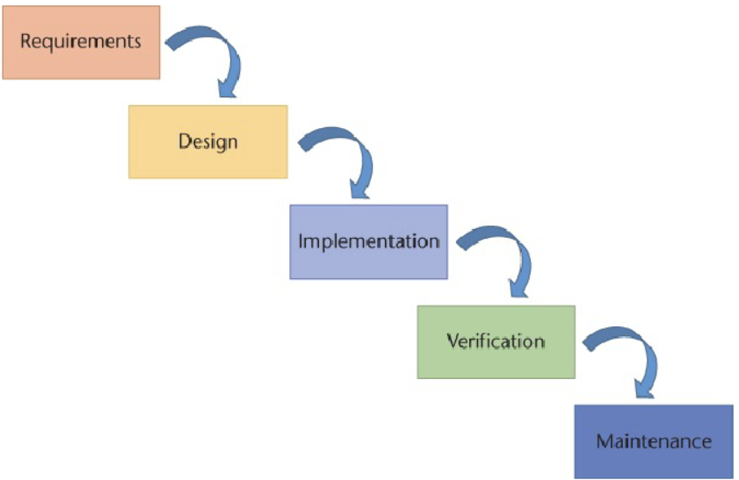
Waterfall Process Model
Common problems:
Requirements requirement
Inflexibility
Loss of opportunity and Time to Market
Customer Dissatisfaction

Slide 7
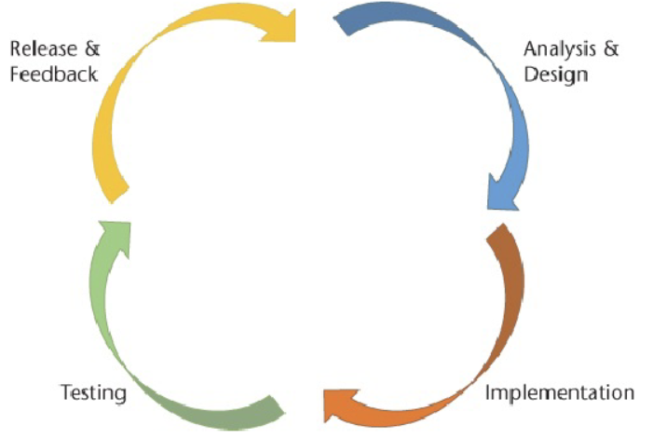
Agile Process Model
Lack of upfront planning
Lack of upfront costs
Agile works well in tech companies where end product is a piece of software, less complex with fewer integrations

Slide 8
Project Approaches
Term project approach has different uses such as technological philosophy and technological decisions. Choices can be between Custom vs Off-the-shelf approach vs hybrid approach.

Slide 9
Discussion
Discuss the advantages and disadvantages of each of the following approaches in coming up with software product:
Custom approach
Off-the-shelf approach
Hybrid approaches

Slide 10
Project strategies?
Project Strategies are methods used to complete a project in the easiest, most efficient way within time and budget.
Incremental strategy
Iterative strategy
One-shot strategy
Phased Strategy
Notes:
Incremental strategy- Used on very big projects, Project is completed in stages.
Iterative strategy-Used in projects that involves repetitive testing, revising and improving e.g., Technical projects, industrial projects
One-shot strategy -Product/service is developed & this project is introduced in one big step. Most used for social projects.
Phased Strategy-A project is introduced in phases. Over a few days, weeks, months or years e.g., Bank Project
introduce new bank teller systems
new savings account systems,
new credit and loan systems

Slide 11
Project environments
Projects exist and operate in environments that may have an influence on them.
Two major categories of influences are enterprise environmental factors (EEFs) and organizational process assets (OPAs).
Enterprise environmental factors (EEFs) refer to conditions, not under the control of the project team, that influence, constrain, or direct the project.

Slide 12
Project influences
Influences
EEFs
External
Internal
Internal OPAs
Processes, Policies, Procedures
Corporate Knowledge

Slide 13
Enterprise Environmental Factors internal to the organisation
Organizational culture, structure, and governance
Geographic distribution of facilities and resources
Infrastructure
Information Technology Software
Resource Availability
Employee capability

Slide 14
Enterprise Environmental Factors external to the organisation
Marketplace conditions
Social and cultural influences and issues
Legal restrictions
Commercial databases
Academic research
Government or Industry standards
Financial considerations
Physical environmental elements

Slide 15
Project Attributes
A project attribute refers to a characteristic or feature of a project that helps describe and define its nature, scope, and key parameters.
Clear objective
Series of interdependent tasks
Various resources
Specific time frame
Unique, one-time endeavor
Sponsor or customer
Degree of uncertainty
Notes:
Project Attributes
A project is an endeavor to accomplish a specific objective through a unique set of interrelated tasks and the effective utilization of resources. The following attributes help define a project:
A project has a clear objective that establishes what is to be accomplished. It is the tangible end product that the project team must produce and deliver. The project objective is usually defined in terms of end product or deliverable, schedule, and budget. Furthermore, it is expected that the work scope will be accomplished in a quality manner and to the customer’s satisfaction.
A project is carried out through a series of interdependent tasks in a certain sequence in order to achieve the project objective.
A project utilizes various resources to carry out the tasks.
A project has a specific time frame, or finite life span - a start time and a date by which the objective must be accomplished.
A project may be a unique or one-time endeavor such as developing a new product, building a house, or planning a wedding.
A project has a sponsor or customer that provides the funds necessary to accomplish the project. In a business setting, the customer can be internal or external to your organization.
Finally, a project involves a degree of uncertainty and is based on certain assumptions and estimates for the project budget, schedule, and work scope.

Slide 16
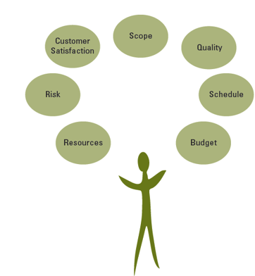
Balancing Project Constraints
Notes:
Balancing Project Constraints
The successful accomplishment of the project objective is usually constrained by many factors, including scope, quality, schedule, budget, resources, risks, and customer satisfaction.
Various resources are needed to perform the project tasks and accomplish the project objective. Resources include people, materials, equipment, facilities, and so on.
Risks adversely affect accomplishing the project objective.
Customer satisfaction goes beyond just completing the project scope within budget and on schedule or asking if the customer is satisfied at the end of the project. It means not only meeting the customer’s expectations but also developing and maintaining an excellent working relationship throughout the project.
Project scope is all the work that must be done in order to produce the project deliverables (the tangible product or items to be provided), satisfy the customer that the deliverables meet the requirements or acceptance criteria, and accomplish the project objective.
Quality expectations must be defined from the onset of the project. The project work scope must be accomplished in a quality manner and meet specifications.
The schedule for a project is the timetable that specifies when each task or activity should start and finish. The project objective usually states the time by which the project scope must be completed in terms of a specific date agreed upon by the sponsor and the organization performing the project.
The budget of a project is the amount the sponsor or customer has agreed to pay for acceptable project deliverables. The project budget is based on estimated costs associated with the quantities of various resources that will be used to perform the project.
During the project, it is sometimes challenging to balance these factors, which often constrain one another and can jeopardize accomplishing the project objective. To help assure the achievement of the project objective, it is important to develop a plan before starting the project work rather than starting without a plan. Lack of a plan decreases the chances of successfully accomplishing the full project scope within budget and on schedule.

Slide 17
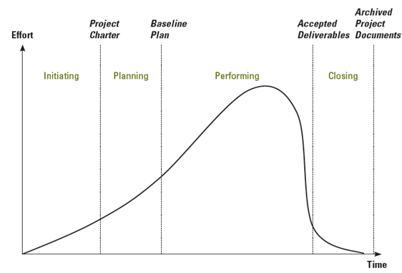
Overview of Project Life Cycle
Notes:
The Project Life Cycle
The project life cycle has four general phases: initiating, planning, performing, and closing the project, which you can see in the figure on this slide.
The time span of each phase and the associated level of effort will vary depending on the specific project.
Project life cycles can vary in length from a few weeks to several years, depending on the content, complexity, and magnitude of the project in question.

Slide 18
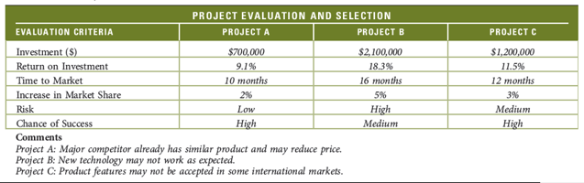
Project Selection
Evaluate needs, costs, benefits
Determine which are projects
Select project
Develop criteria
List assumptions
Gather data
Evaluate each opportunity
Combine “gut” feelings and quantitative information to make decision
Occurs at stage 1 of project lifecycle

Slide 19
Request For Proposal
A Request for Proposal (RFP) is a formal document that organizations use to solicit proposals from potential vendors or service providers for the procurement of goods, services, or projects.
RFP outlines the requirements, specifications, and criteria that the organization is seeking, and it serves as an invitation for interested parties to submit detailed proposals outlining how they can meet those requirements.
An RFP states, comprehensively and in detail, what is required, from the customer’s point of view, to address the identified need.
Notes:
A good RFP allows contractors or a project team to understand what the customer expects so that they can prepare a thorough proposal that will satisfy the customer’s requirements at a realistic price.

Slide 20
Preparing a Request for Proposal
Decision made to outsource to external resource
Comprehensively describe project requirements
Includes need, problem, or opportunity description
Allows contractors to develop a thorough proposal
Facilitates the development of evaluation criteria
May be communicated informally or formally, in writing or verbally.
If there is no capacity, project can be outsourced.

Slide 21

Outsourcing Projects
Discuss the advantages associated with outsourcing projects?
ⓘ Start presenting to display the poll results on this slide.

Slide 22
Outsourcing Projects
Discuss the disadvantages associated with outsourcing projects?
ⓘ Start presenting to display the poll results on this slide.

Slide 23
Key parts of a Request for Proposal
Introduction
Scope of Work
Submission guidelines
Evaluation criteria
Budgeting and Pricing
Terms and conditions
Proposal Format
Contact Information
Notes:
Introduction- Purpose and objectives of the procurement
Scope of Work-Highlights specific tasks, deliverables, and performance expectations and any technical requirements or specifications.
Submission guidelines-proposal submission deadlines and how the proposal will be submitted.
Evaluation criteria-Contains any specific scoring or ranking methodology.
Budgeting and Pricing-contains information on how pricing proposals should be structured.
Terms and conditions - Legal and contractual requirements.
Proposal Format-Required format for submitting proposals.
Contact Information-Names and contact details of individuals or points of contact for inquiries or clarification

Slide 24
Initiating Phase
First phase also referred to as concept
Key document-Project charter
Identify need, problem, objective opportunity, or mandate, expected benefits
General requirements and conditions
Various ways for identification:
Determine if to select project
Decide if Request For Proposal is needed
Notes:
The project charter is a document that formally authorizes a project or phase.
The project charter defines the reason for the project and assigns a project manager and his or her authority level for the project.
Contents- Project purpose, project boundaries, key deliverables, anticipated risks, summary milestones schedule
The project charter can receive information from: Agreements (contracts) Statements of work, Business case, Benefits management plan

Slide 25
Planning Phase
Second Phase also referred to as definition stage
Show how project scope will be accomplished
Establish project objective
Define scope
Create WBS
Assign responsibility
Define specific activities and Sequence activities
Estimate activity resources
Develop project schedule
Estimate activity costs
Determine budget
Notes:
What needs to be done -- scope, deliverable
How it will get done -- activities, sequence
Who will do it -- resources, responsibilities
How long it will take -- durations, schedule
How much it will cost -- budget
What the risks are

Slide 26
Performing Phase
Third phase/development/implementation
Accomplish project objectives
Project manager leads
Project team completes the project
Increase pace as more resources are added
Monitor and control progress
Take corrective action as needed
Manage and control changes with sponsor approval
Achieve customer satisfaction with acceptance of deliverable

Slide 27
Closing Phase
Final phase/handover and closure
Collect and make final payments
Recognize and evaluate staff
Conduct post project evaluation
Document lessons learned
Archive project documents
Record lessons learned

Slide 28
Some Terms
Project Charter authorises the project.
Project Scope Statement: indicates which work is to be done & which deliverables is to be produced.
Project Plan: A detailed plan which states how work should be conducted.
A work breakdown structure, or WBS, is a hierarchical decomposition of the project scope into work elements to be executed by the project team and produce the project deliverables.
Sequencing activities involves creating a network diagram that shows the necessary sequence and dependent relationships in a project.
Developing project schedule involves determining the start and finish times for each activity to complete the project by its required completion date.

Slide 29
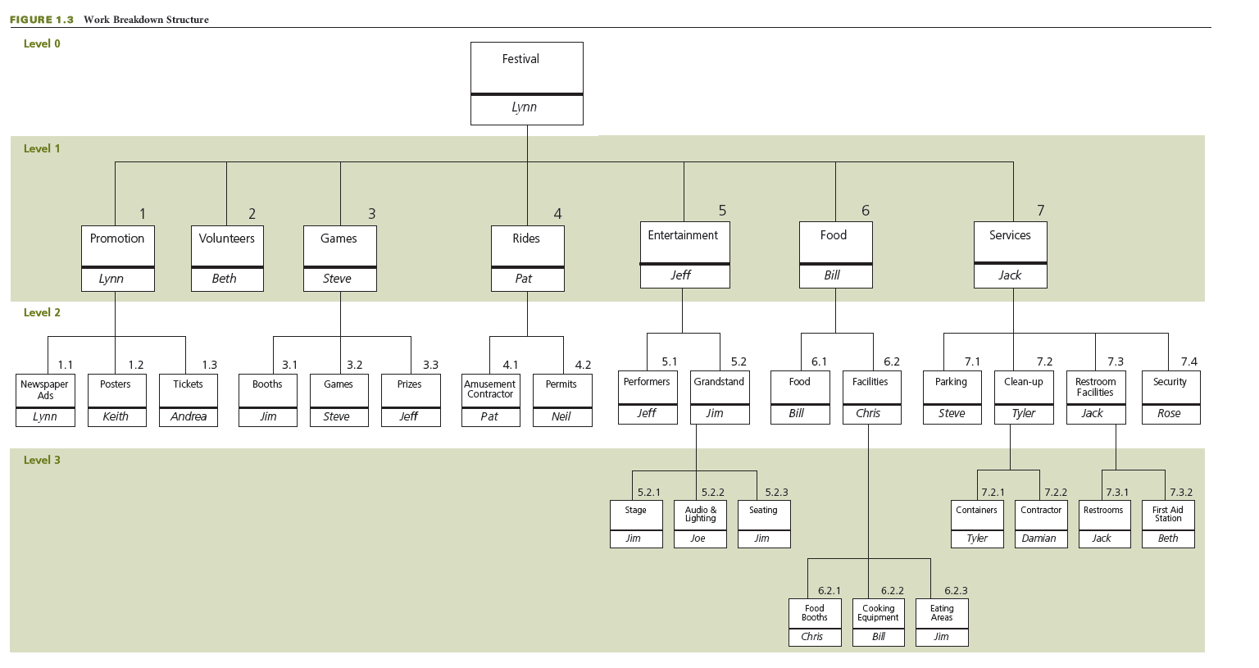
Create WBS and Assign Responsibility
Notes:
Create WBS and Assign Responsibility
A work breakdown structure, or WBS, is a hierarchical decomposition of the project scope into work elements to be executed by the project team and produce the project deliverables.
You can see a WBS in this slide.
Assigning responsibility involves determining who will be the person or organization responsible for each work item in the WBS.
A Project manager can use a WBS to show:
The goals and activities of a project
The structure of the project
The structure of the budget
Timeline of the project

Slide 30
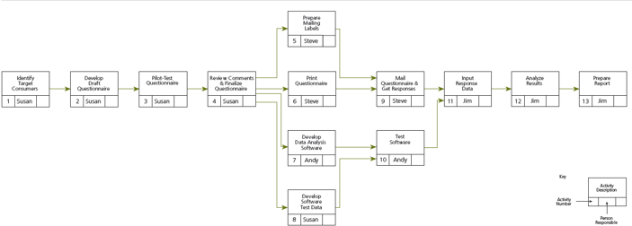
Sequence Activities
Notes:
Sequence Activities
The figure on this slide shows a network diagram that reveals the sequence of activities for a project.
Sequencing activities involves creating a network diagram that shows the necessary sequence and dependent relationships in a project.

Slide 31
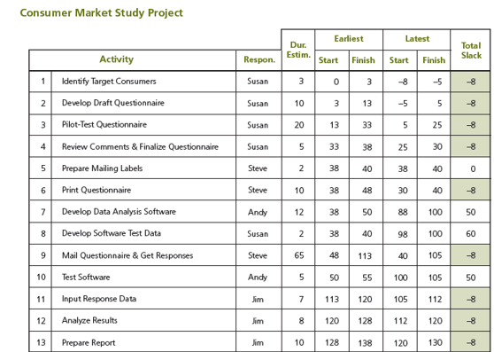
Develop the Project Schedule
Notes:
Develop the Project Schedule
This table shows the project schedule for a consumer market study project.
Developing project schedule involves determining the start and finish times for each activity in order to complete the project by its required completion date.

Slide 32
Statement of Work (SOW)
It defines project deliverables, activities and timeline and given to a vendor providing services to the client.
Items are included in statement of work
The project deliverables
The goals and objectives
The cost and time estimates
The list of stakeholders
The chain of command
Assumptions and agreements
The communication plan

Slide 33
Four possible responses to a risk
Accept the risk – this should occur when you are unable to develop a strategy
Avoid the risk by changing the project plan to eliminate the risk
Reduce the risk. Minimise the likelihood of the event happening/minimise the impact of the risk.
Transfer the risk. The impact of the risk is transferred to a third party, for example by insuring against the risk.
Not all risks are negative - some risks can have a positive effect on the project.

Slide 34
Summary

Slide 35
Key takeaway points
Introduction
Project types and nature
Defining common software process models
Different project approaches
Request for proposal
Project Lifecycle
Project Strategies

Slide 36
Next Lesson
Developing a project proposal

Slide 37
References
A Guide to the Project Management Body of Knowledge (PMBOK® Guide), Project Management Institute, 2017.
Simon, P. and Murray-Webster, R., 2018. Starting out in project management. Association for Project Management.
Snyder, D, C.(2017). A Project Manager's Book of Forms : A Companion to the PMBOK Guide, John Wiley & Sons, Incorporated.. .

Slide 38
Prioritisation
List the key actions that a project manager should prioritize during a project.
ⓘ Start presenting to display the poll results on this slide.

